Slide 1
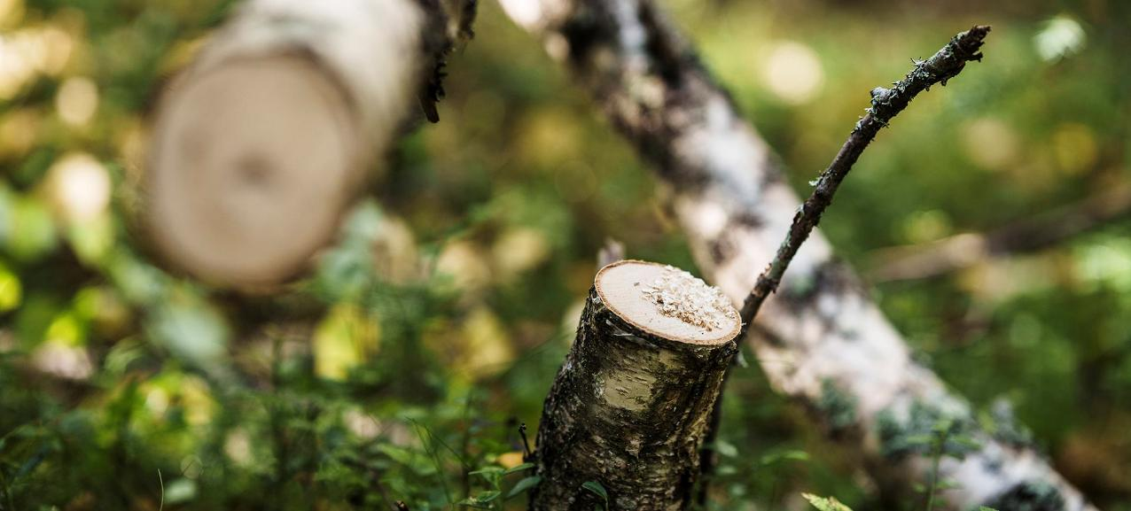
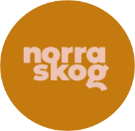
Norra Skog

Slide 2
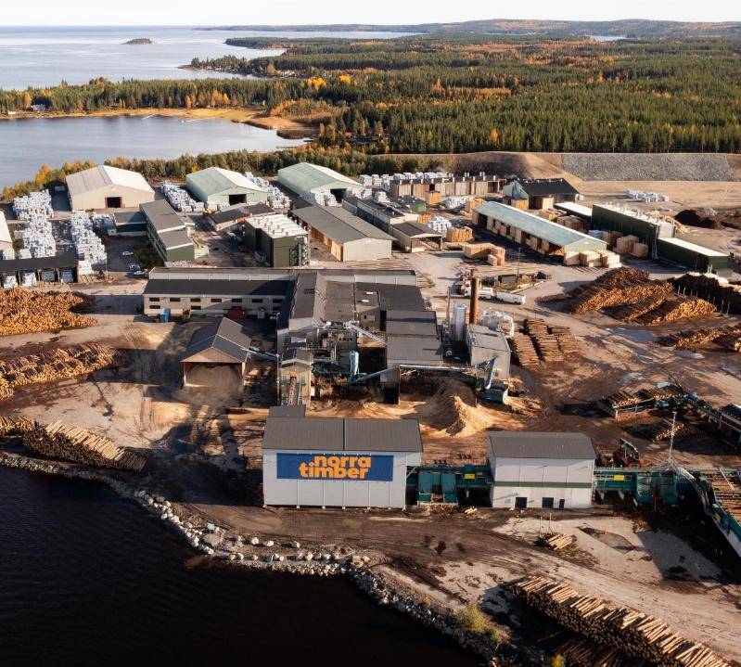
Norra Skog
Cooperative
Owned by 27 000 members that are private forest owners
Own industries
3 sawmills, 3 construction product facilities, 1 pole factory, co-owner of a pulp mill
Operational area
Northern part of Sweden

Slide 3
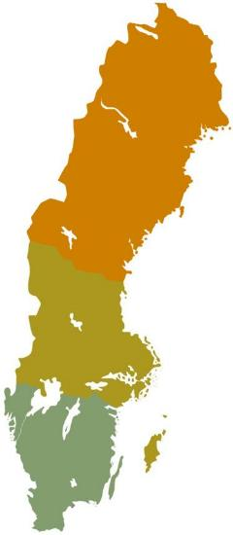



Forest owner associations in Sweden
Hållbarhet
Tillsammans
Glädje!
Notes:
8 % has the income from forest as primary income (whole Sweden)
44% works at least 20 days / year in their property (northern Sweden)
Ordinary member, senior member and family member

Slide 4
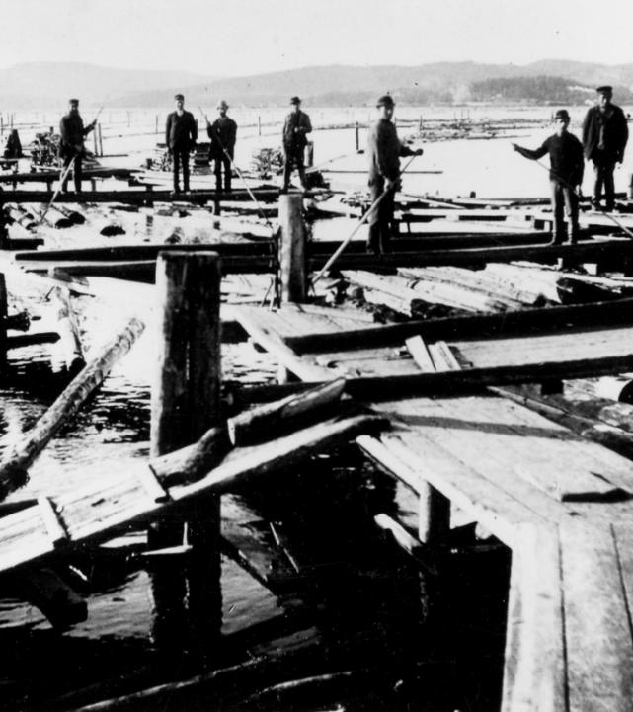
Why do forest owner associations exist?
Notes:
By the end of 18th century, forestry had become an important part of the economy. But well into the 20th century, forest owners had no influence over timber sales, price formation and how timber was measured. Forest owners had little to say on the market. An association was a way to join forces and become a player on the timber market.

Slide 5
Norra Skog in numbers
670 employees
800 persons as contractors
2,2 million ha of productive forest land owned by members
266 million SEK in profit sharing to members in 2025
5,7 billion SEK in total turnover 2024
Notes:
Satu

Slide 6
Democratic organisation
Small local associations
One member – one vote
General Assembly
Swedish Code for Governance for Cooperatives
  a voluntary framework aimed at promoting member dialogue, democratic processes, and transparency

Slide 7
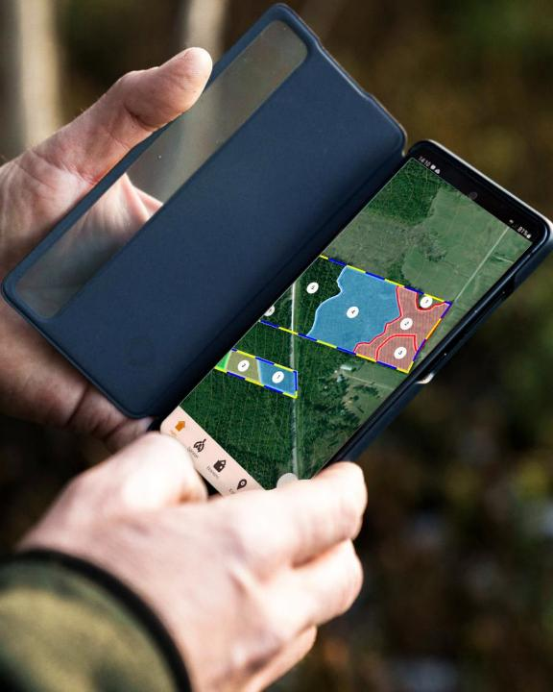
Services
Advisory services related to forest management
Tax declaration and legal services
Forest road planning and building
Courses and other learning opportunities
Advocacy work related to forest and industrial policy
Real estate services
Notes:
Satu

Slide 8
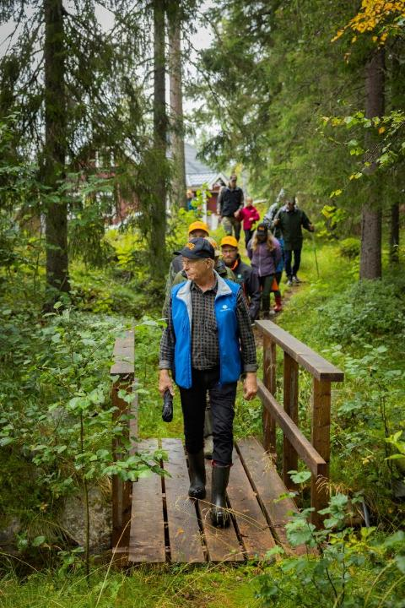

Spreading awareness on water conservation and management
In Grip on Life IP project, authorities, forest owners' associations and NGOs work together to combine modern and active forestry with consideration to the forest's valuable watercourses and wetlands.
Demo sites: a trail with info signs
Water walks
Information material
Notes:
Our goal is to improve the environment and conditions for animals and plants that depend on watercourses and wetlands in the forest landscape, while we continue to use our natural resources in a sustainable way and preserve important habitats for animals and plants for the future.

Slide 9
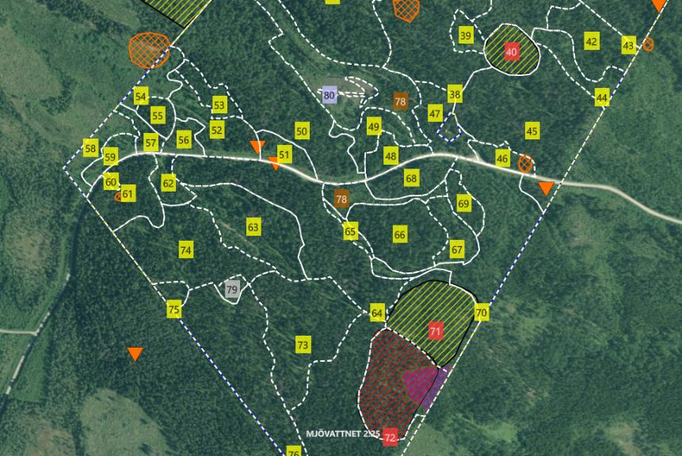
Forest management plan
Notes:
Orange: Historical sites to be preserved (for example charcoal production sites). Areas and points depending on the nature and size of the site.
Yellow: High nature values. Set aside area.
Red: Key habitats. No total ban on harvesting but certification rules (FSC/PEFC) make it difficult to sell timber from these areas.
Purple: Habitat protection under the Environmental Code, small, valuable natural environments that serve as important habitats for threatened species or contribute to biodiversity.

Slide 10
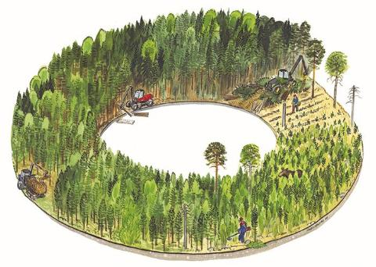
The Swedish forestry model
70-85 years
Final felling
25-70 years
Thinning
12-18 meters
5-25 years
Pre-commercial thinning
1-5 meters
0-3 years
Soil preparation and reforestation
0-1 meter
Notes:
Clear-cutting is the predominant forest management system in Sweden. It is combined with various environmental protection measures, ranging from the preservation of entire forest areas to specific actions that promote biodiversity in each management activity – for example, leav
Scots pine
Pinus sylvestris
Norway spruce
Picea abies
Birch
Betula pendula, Betula pubescens
ing broad-leaved trees and deadwood in place.

Slide 11
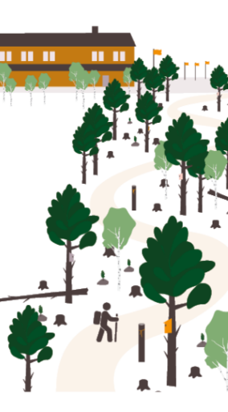
Alternative methods
Social values
Biodiversity values
Historical values
Esthetic values
Variation in site conditions
The forest owner’s management objectives and priorities
E.g. continuous-cover forestry, gap-based harvesting regimes
Notes:
The foundation of all forest management is to first understand the site conditions and the ecological and social values present in the forest. Based on this knowledge, one can determine which objectives should be prioritized and developed. Once these priorities are established, appropriate management strategies are selected to guide the forest’s development toward the defined goals.” Sometimes the Forestry Act sets boundaries for which forest management method one can use.
reflecting the country’s pronounced north–south gradients in climate, productivity, and stand dynamics.”

Slide 12
Future opportunities and challenges
Storms, fires, insects, climate change, biodiversity
Meeting policy goals vs. meeting societal expectations
Cooperative as a business model
Thank you!

