Slide 1

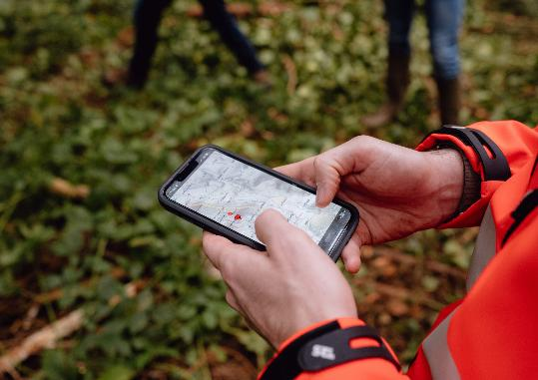
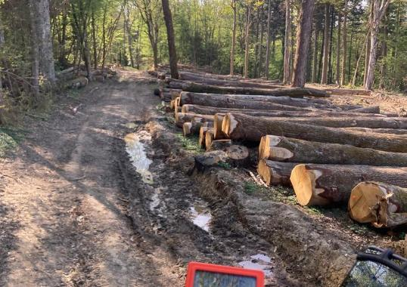
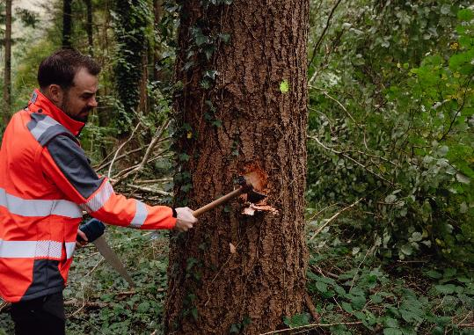
Forest cooperatives in France
Mr Tammouz Eñaut HELOU
Secretary general
Union de la Coopération Forestière Française (UCFF)
ERIAFF, 12 MAY 2026 (AMSTERDAM))

Slide 2
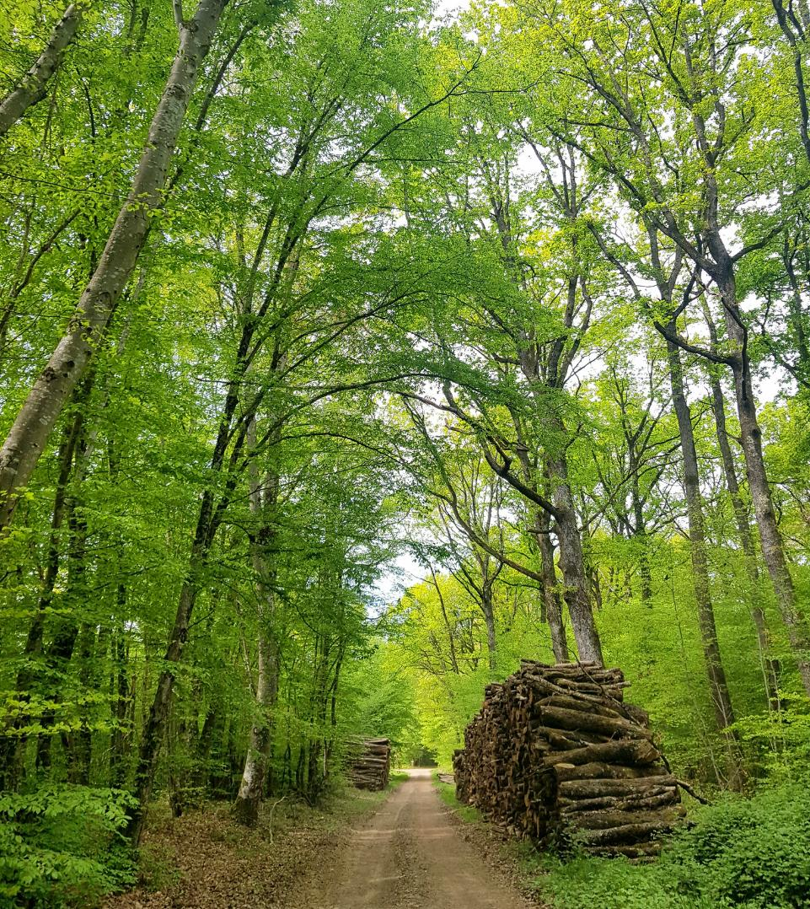
Some topics
1
Forests & forestry sector in France
2
Private ownership
3
French forest cooperatives
4
Challenges & recommandations

Slide 3
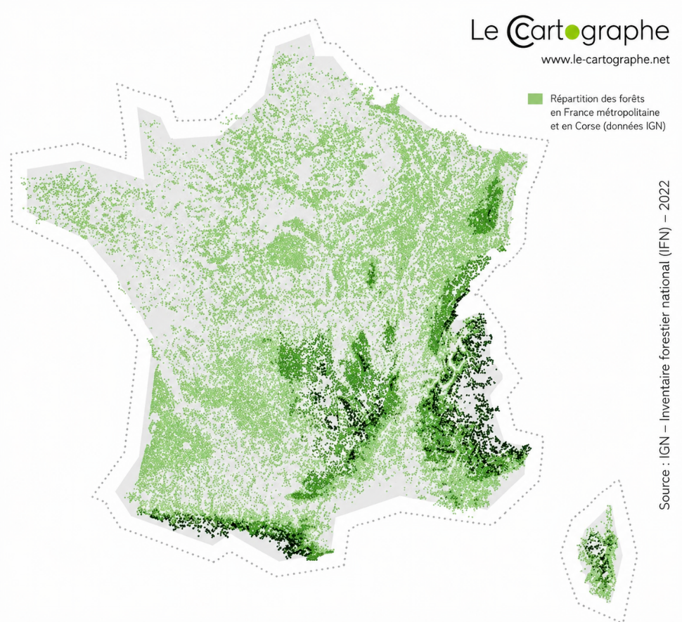
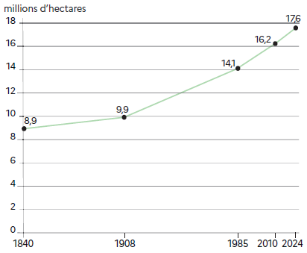
Forests & forestry sector in FR
  17.6 Mha (32 %), vs 9.9 Mha in 1908
  75 % private forest (13.2 Mha)
    with 3.4 M private owners

Slide 4
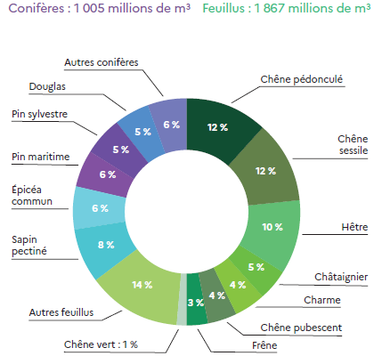
Forests & forestry sector in FR
  190 foresty trees
  Diversified forests
  Multifunctionality
  17.6 Mha (32 %), vs 9.9 Mha in 1908
    65 % hardwood stands
    13 % mixted
    20 % softwood stands
    < 1 % poplar trees

Slide 5
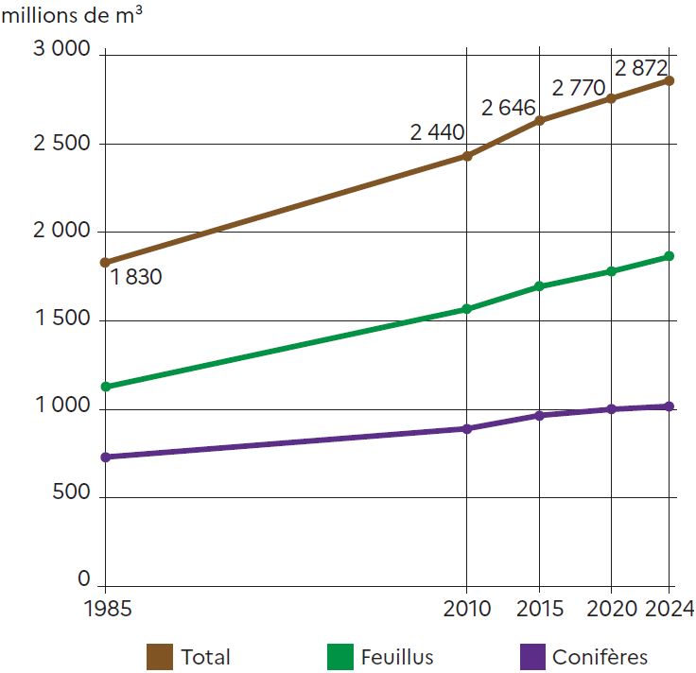
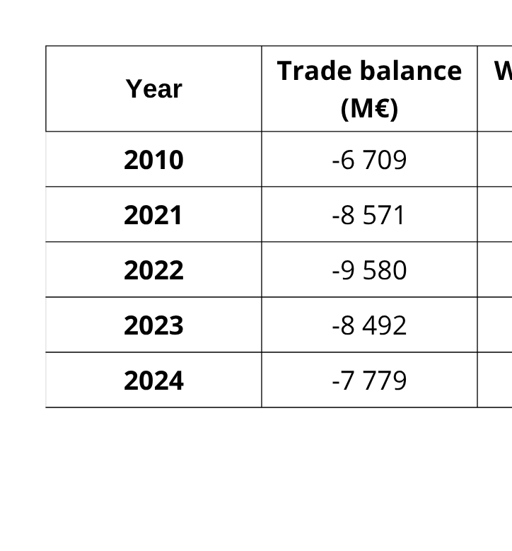
Forests & forestry sector in FR
  Volumes :
    + 50 % in 40 years
    66 % hardwoods
  Harvest : +/- 40 Mm3/year

Slide 6
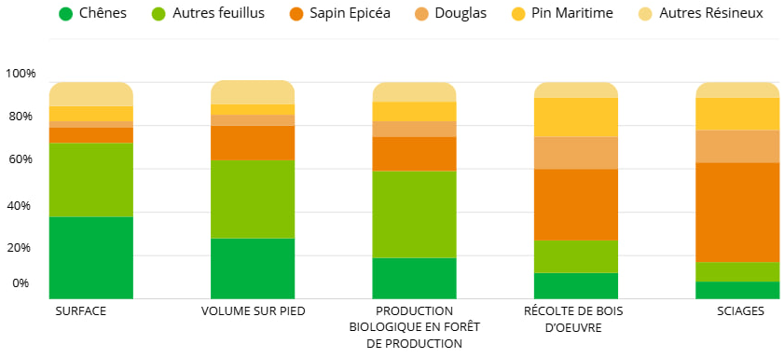
Forests & Forestry sector in FR
Forests & forestry sector in FR
  Harvested wood : 38 Mm3
    18 Mm3 logs
    10 Mm3 puplwood
    10 Mm3 energy wood
  Sawn wood : 8 Mm3
    1 Mm3 harwood
    7 Mm3 softwood

Slide 7
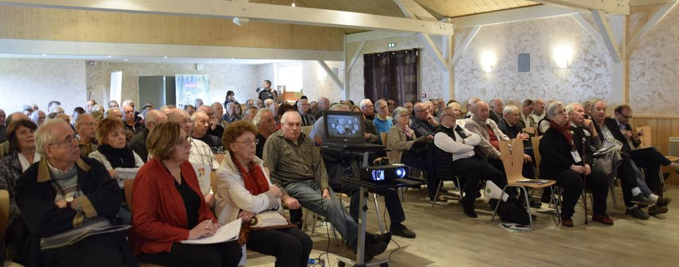
Private forest ownership
Size | Private Owner (PO) | Forest area (ha) | Average (ha/PO)
< 1 ha | 2 203 000 | 687 000 | 0.57
1-4 ha | 729 000 | 1 463 000 | 2.00
> 4 ha | 377 000 | 6 929 000 | 18.37
  75 % private forest (13,2 Mha)
  Belong to 3.4 M private owners (PO), so an average of 3.8 ha per PO
    > 1 ha = 1 142 000 PO (8,38 Mha, average 7.34 ha)
  Forest area (ha)
    50 % without any forestry operations since 50 years
    27 % ha only with sustainable management plan

Slide 8
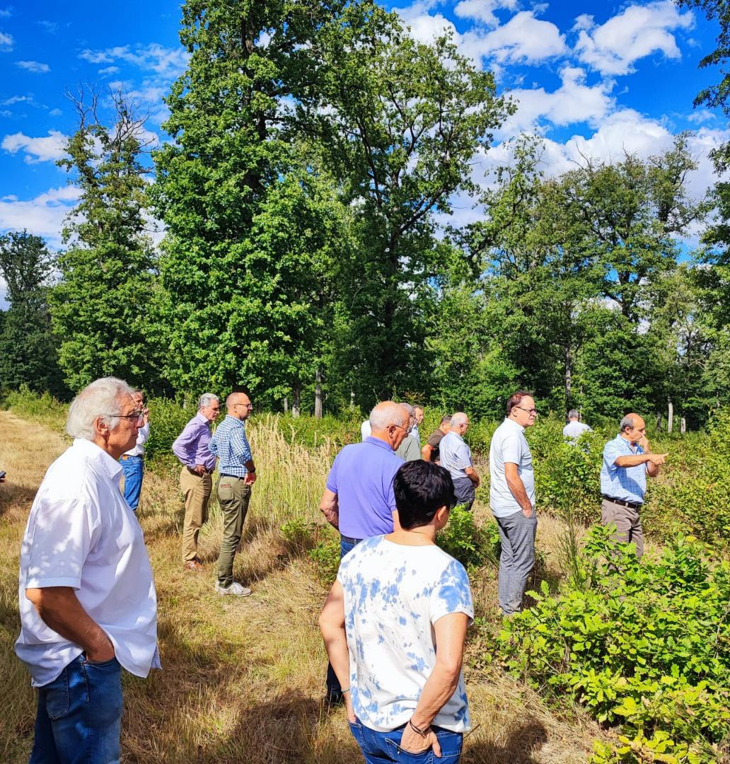
Private forest ownership in FR
Trends (mostly)
  Family forest owners (inherit forest from their parents)
  Non-professionals
  Living in cities
  Varied profiles & expectations : wood production, gaming, carbon, biodiversity, soils...
  Impacts of digital social networks “debates”

Slide 9












12 french forestry cooperatives
  “We bring together forest private owners and support them with a global offer to make them active participants in the sustainable management of their forests”
  Same 3 services for all :
    Management advices
    Purchasing center
    Wood sales
  National coverage
  Democratic rules (decision process, transparency, “1 person, 1 voice”...)
  Global solutions/services for PO

Slide 10
What we do for our sector
  We help PO to manage their forests
  We work for a competitive upstream/downstream sector (providers, contractors, clients)
    We structure the upstream market
    Long term contracts
  We implement public policies in private forests

Slide 11
12 french forestry cooperatives
  110 000 private owners (PO) & 2 Mha
  1 500 employees
  238 administrators (PO)
  40 % of reforestation in FR
    15 000 ha/year
  20 % of timber harvest in FR
    7 Mm3/year
    70 % sales through “wood supply contract”
    80 % certified PEFC or FSC

Slide 12
12 french forestry cooperatives
  Involve in tens of innovation projects (from seeds to logistical issues)
    20 dedicated employees
  Access to PEFC/FSC certifications
    78 % PO & 67 % ha in France from cooperatives
  Current investments for the sector
    Seed orchard
    Nursery
    Forestry works
    Sawmills
  Carbon, nature credits...

Slide 13
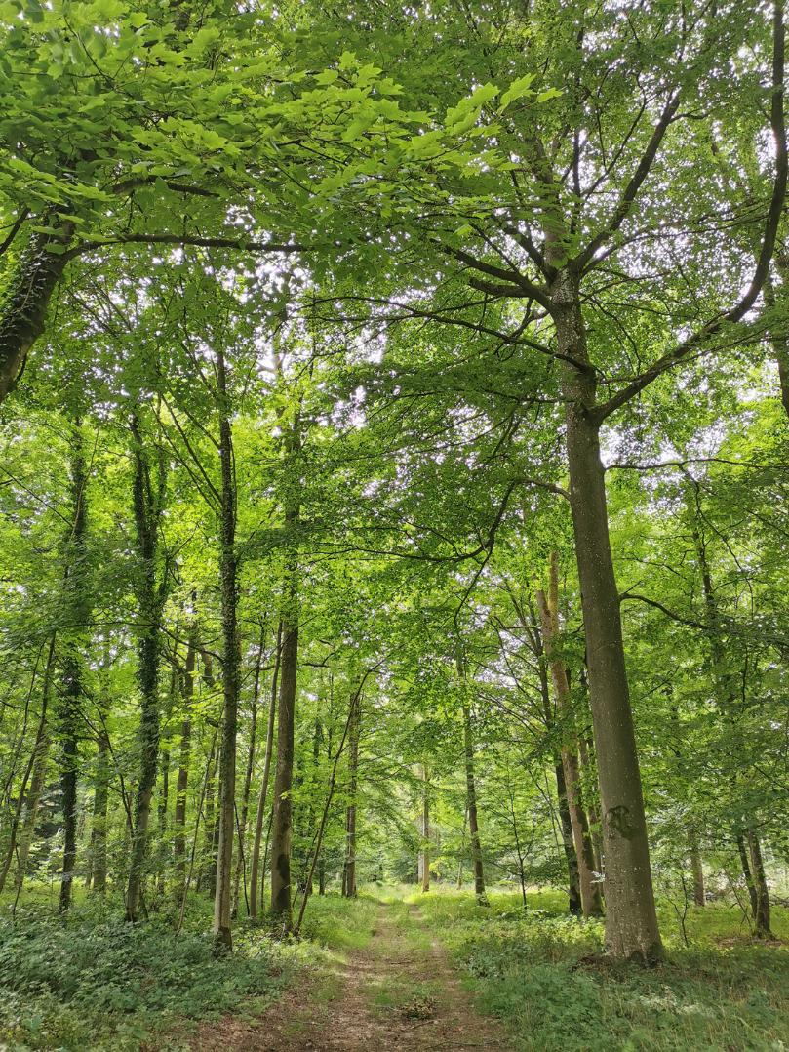
Our main concerns
  Motivate private owners
  Adapt forests to climate change
  Protect employees (safety, vandalism...)
  Protect environment (soils, biodiversity...)
  Skilled workforce
  Multifunctionality & Competitivness

Slide 14
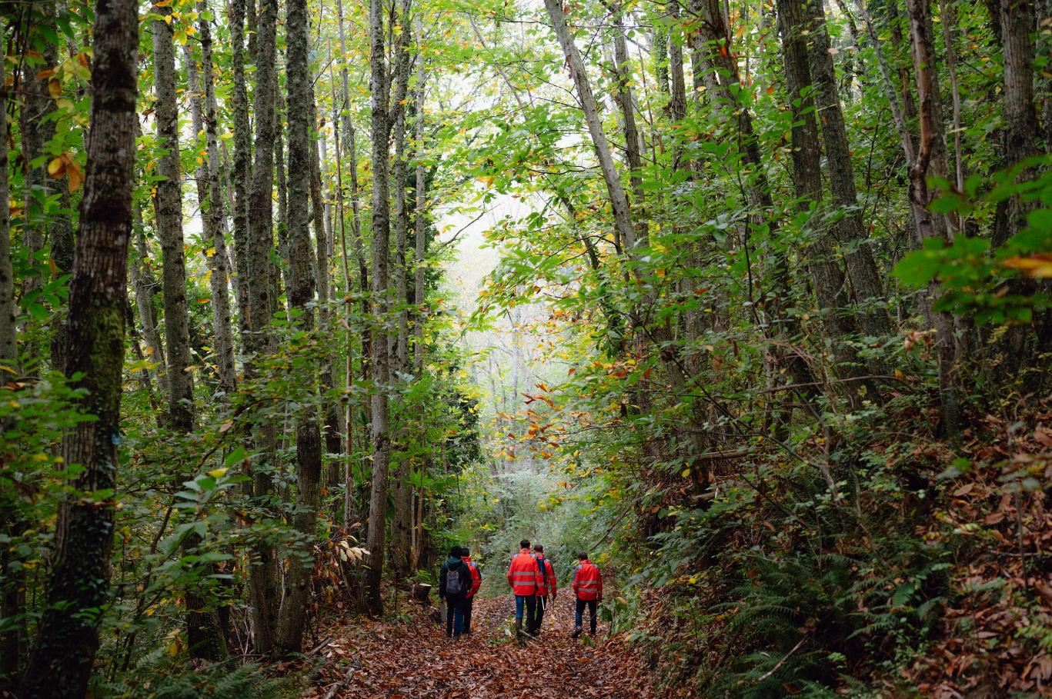
Recommandations
  A private owner must be connected with a profesionnal forest manager
  Public policies must encourage
    active sustainable forest management
    wood-based products use
  Ensure national & EU regulations coherence
  Explain to the “society” the importance of forest management and use of wood

Slide 15
Thank you for your attention
Mr Tammouz Eñaut HELOU
Secretary general
ERIAFF, 12 MAY 2026 (AMSTERDAM))
Union de la Coopération Forestière Française (UCFF)
47 rue de Rome 75008 Paris - info@lescooperativesforestieres.fr
lescooperativesforestieres.fr

